Slide 1


Pressure Injuries
using SSKIN
Care Worker Training Module
Created by the Te Waipounamu | South Island Aged Residential Care Pressure Injury Prevention Working Group 2025
Presenter: Mandy Pagan CNS Wound Health NZ Southern
Notes:
Kia ora and welcome to "STOP Pressure Injuries using the SSKIN framework." This presentation is part of a practical resource kit designed to support care workers in preventing pressure injuries. Developed by the Te Waipounamu Working Group, it offers clear, hands-on guidance to promote safe, effective care in everyday practice.

Slide 2

Learning Objectives
To understand what a pressure injury is and how they can occur
To identify stage 1 and suspected deep tissue pressure injuries
To increase knowledge and confidence on how to prevent pressure injuries using SSKIN and prevent them from worsening
Notes:
Care workers provide more direct resident care than nurses, such as repositioning, continence and hygiene care. Your role is so important to preventing PIs

Slide 3
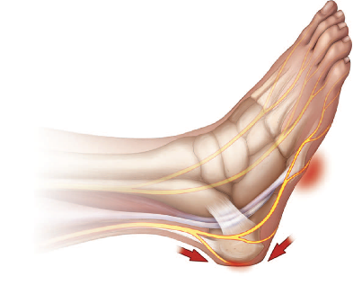
Pressure Injury Definition
Local damage to skin and/or underlying tissue caused by pressure or pressure and shear.
Shear occurs when one layer of tissue slides over another deforming and disrupting blood flow.
Mostly occur over bony prominences OR related to medical devices or objects.
Can develop in hours and usually begin with the skin changing red in colour.
Can develop into deeper wounds.
Consider your residents risk factors….
Most common bony sites for pressure injuries: hips, heels and sacrum
Notes:
Pressure can cause the skin, blood vessels, subcutaneous fat, or muscle tissue to be compressed and sheared internally between internal structures such as bones and an outside surface such as cushions, mattresses or (medical) devices such as catheters. This reduces the blood flow and tissue perfusion leading to a shortage of oxygen and nutrient supply causing an accumulation of waste products eventually leading to cell death. We understand muscle tissue is much more susceptible to ischemia compared to skin. External skin friction is a contributing factor, especially in superficial injuries, while deeper ulcers are linked to more complex processes. Explaining to residents: ‘Standing on the garden hose analogy’. The heel has a small surface area = higher pressure & has little fat or muscle for cushioning.
Immobility is the leading cause of PIs and hence People with disabilities, who are bed or chair bound are at higher risk of developing these. Also consider loss of sensation so unable to report or move of the affected area and any sudden unwellness leading to immobilty

Slide 4
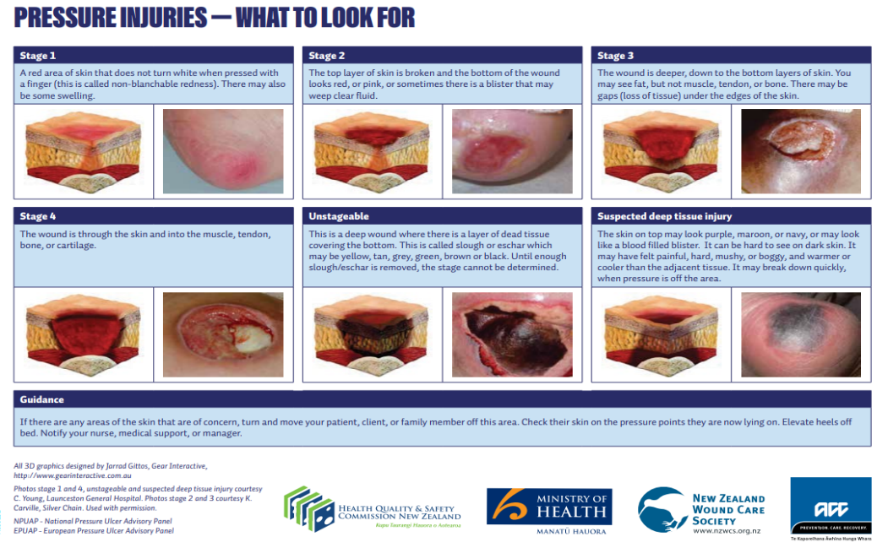
National Pressure Ulcer Advisory Panel, European Pressure Ulcer Advisory Panel and Pan Pacific Pressure Injury Alliance. Prevention and Treatment of Pressure Ulcers: Clinical Practice Guideline. Emily Haesler (Ed.). Cambridge Media: Osborne Park, Western Australia; 2014
Notes:
Pressure injuries are staged according to their severity. As care workers, you play a vital role to identify and report stage 1 and SDTI PIs to your nurses and educate your resident

Slide 5
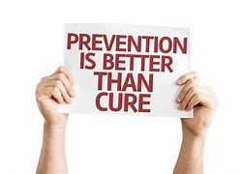
Prevention is key
Majority are preventable, costly to treat, cause pain, affect quality of life, can cause disfigurement, have high recurrence rates, and can even lead to death.
SSKIN is a five-step approach to preventing and treating pressure injuries.
Nurses and care-workers working together can PREVENT these occurring.
Consider cultural safety for residents. Refer to HQSC Pressure Injury Frailty Care Guide for implications for kaumātua.
Your residents need YOU!
Notes:
Health & Disability Commissioner investigations have occurred from preventable PIs occurring in care

Slide 6
SSKIN
S = Surface
S = Skin Inspections
K = Keep Moving
I = Incontinence
N = Nutrition
The SSKIN acronym alerts nurses and care-workers of strategies to prevent or manage pressure injuries​
Apply SSKIN into your everyday practice
​
Report any resident concerns to your nurse

Slide 7
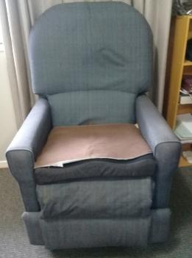
Surface
Question: Can seat protectors, towels, or sheets over pressure relieving equipment (mattresses or cushions) reduce their effectiveness?
Yes!
For at risk residents pressure reducing mattress, seat cushion and heel lift devices (or float heels off the bed) are recommended
Check bedding, chairs, clothing, footwear etc. are safe and in good repair
Donut shaped cushions increase pressure and should not be used for pressure relief
Keep surfaces clean and dry
Are your waterproof mattress and cushions cleaned regularly?
X
Notes:
Sadly often pressure reducing equipment is put in place once the PI has developed – the equipment should be used to prevent and manage PIs. Ask your residents if they are comfortable on the these surfaces, if not they need to be reassessed. Physiotherapists and occupational therapists are experts in this area. Immobile residents who have a pressure relieving mattress still require repositioning.

Slide 8
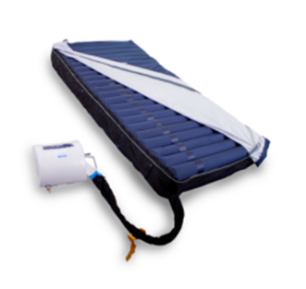
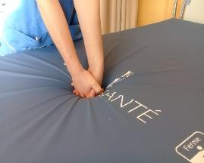
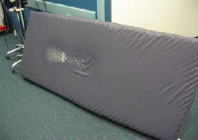
Surface: Mattress Checks
Check for mattress foam fatigue or ‘bottoming out’. Check mattresses at least annually.
Bed at hip level. Link hands to form a fist, keep elbows straight and lean forward, apply full body weight to the mattress. Repeat along the mattress.
If the base of the bed can be felt through the foam, OR if <5cm of foam is present between the fist and base of the bed, they should be replaced.
Inspect mattress covers and inside for staining and tears.
Ensure the air cells in alternating mattresses are inflating, on the correct setting and is comfortable for your resident.
Notes:
Note the mattress indentation (foam fatigue), the cover is cracked (white), allowing body fluid to pass into the foam mattress.
If an air mattress is in place check this daily to ensure it is inflated, air cells can become punctured and should be checked they are in working order

Slide 9
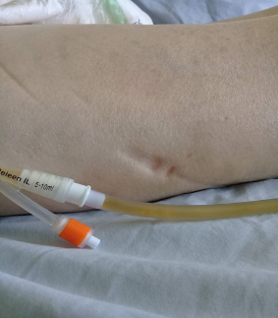
Skin inspections = early detection
Listen, Look, Feel & Report:
Intact skin that is red, purple or maroon
May be missed in dark skin, so check affected skin area for pain, warmth or coolness, boggy or hard skin.
Ask: "is your bottom or heels tender or sore?"
Remember to check inside footwear and look under or around medical devices (e.g. oxygen tubing, catheters).
Notes:
Use the pads of four fingers of one hand to palpate for boggy or hard skin. Research shows that using just a single finger to palpate was not enough to assess this.
Use the back of your hand to assess body temperature.

Slide 10
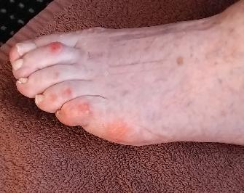
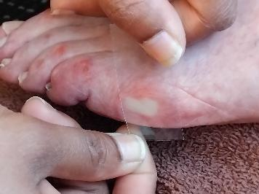
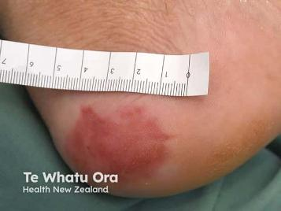
RED SKIN ALERT!
Red skin: apply 3 seconds firm finger pressure then remove to assess response
Skin that turns white when pressure is applied is a normal skin response
Stage 1 pressure injury: red skin areas that stay red when pressed. Remove any pressure and inform the nurse.
Image sourced from DermNet
Notes:
Assess for pressure relief equipment

Slide 11
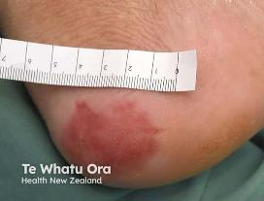
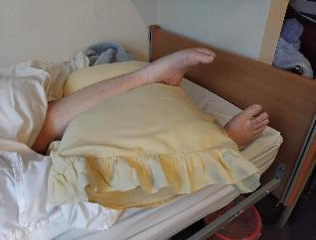
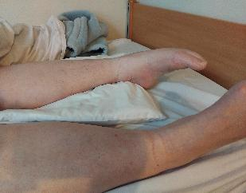
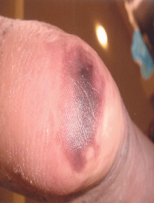
Skin inspections = early detection
Off-load pressure and reposition devices
Stage 1 pressure injury
Suspected deep tissue injury
Question: Can massage help improve circulation to reddened skin?
NO!
Notes:
Stage 1 will resolve if pressure is removed. Discoloured purple or maroon skin that may look like bruising (suspected deep tissue injury). Ensure devices remove heel pressure, if devices have air cells ensure they are inflated. Keep repositioning on these devices and checking skin for any deterioration.
Do not massage red skin or pressure injuries.

Slide 12
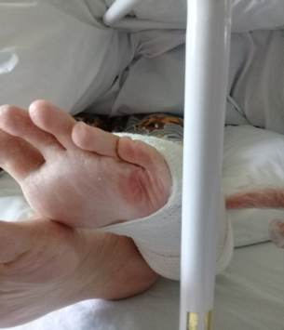
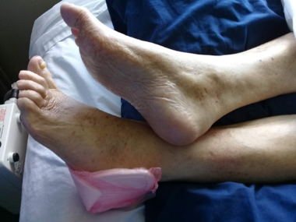
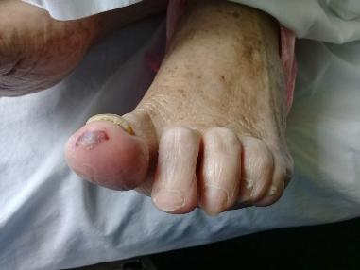
Skin Inspections & Remove Pressure!
Left heel (with dressing) is not elevated off the bed and potential for further pressure injuries if the right heel pressure is not removed from the leg
Suspected deep tissue injury on the great toe caused by tight bed sheets
A bed cradle causing pressure and skin redness on the foot
Notes:
Lack of sensation increases the risk of PIs

Slide 13
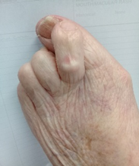
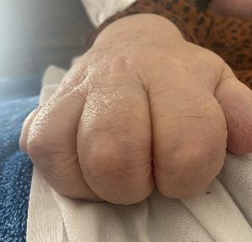
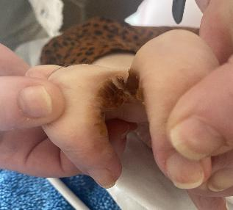
Skin inspections
Don’t forget to check and clean between toes and fingers!
Residents with hand contractures or foot deformities can develop skin breakdown and pressure injuries.
Keep these areas dry (avoid cream between fingers and toes).
Keep toe and fingernails short and filed to prevent injuries.
Dressings or cloths may be needed to separate toes and fingers and reduce pressure, talk to your nurse for more guidance.
Notes:
Assist residents with hand hygiene after toileting and before eating.

Slide 14
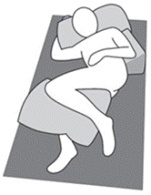
Keep Moving
Residents unable to reposition themselves or are immobile are most at risk for pressure injuries.
Regular movement or turning redistributes pressure, improves blood flow to the affected area and helps prevent skin damage.
Safe Handling: Use x2 ‘slide-sheets’ to reduce friction & shear.
For residents who need help, reposition in bed at least every 2 hours. The 30-degree side tilt is a method of positioning to reduce pressure between the person and support surface.
Question: Do residents nursed on a support surface (e.g. air mattress or seat cushion) still need to be repositioned?
Yes!
Image used from: National Pressure Ulcer Advisory Panel, European Pressure Ulcer Advisory Panel and Pan Pacific Pressure Injury Alliance. Prevention and Treatment of Pressure Ulcers: Clinical Practice Guideline. Emily Haesler (Ed.). Cambridge Media: Osborne Park, Western Australia; 2014
Notes:
Reminder that people with disabilities, including those who use wheelchairs or are bedbound, experience higher rates of pressure injury. Encourage/remind the individual to self-reposition regularly. Residents with agitation or dementia use person-centred care approaches (e.g. distraction, music therapy).
The NZ Spinal Trust has resources including videos on pressure injury prevention for people with spinal cord injuries (see reference slide).

Slide 15
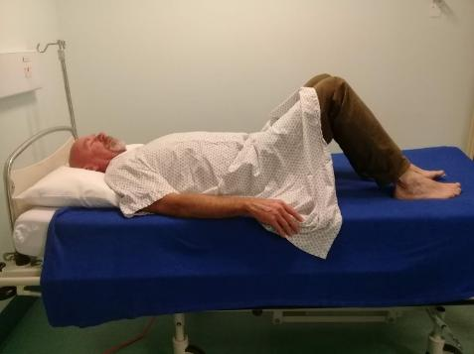
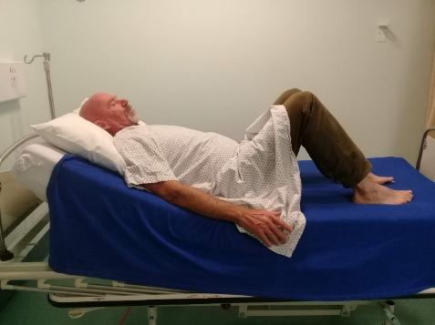
Reduce Pressure Risk over the Heels and Sacrum
Before sitting advise residents to bend their knees, then elevate the head of the bed. This will reduce friction and shear over their heels and bottom. Assist bending their knees if they are unable to.

Slide 16
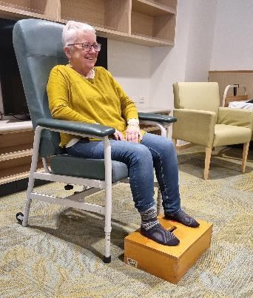
Intensity & duration of pressure
Pressure intensity is higher when sitting. A resident needs more frequent moving when sitting vs lying.
Ensure seating is correct size, resident is not sliding in the chair, feet are supported.
Reposition immobile residents in chairs at least hourly or encourage them to perform bottom-lifts every 20-min.
Some residents may need more frequent turning if the skin turns becomes red from pressure.
Notes:
Try this test: When sitting place your hands under your bottom and feel the intensity of your sit bones, lean forward and lie back to feel how the intensity of pressure is increased or reduced.

Slide 17
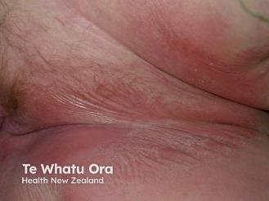
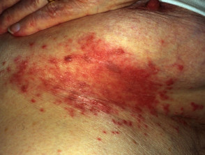
Incontinence
Follow your facilities skin care regime.
Clean and dry skin reduces friction and risk of developing pressure injuries.
Ensure regular toileting regime.
Use soap substitute to clean the skin.
Apply thin layer of barrier cream to protect inner thighs and buttocks from incontinence before skin redness develops.
Nursing assessment may be required to establish cause of faecal incontinence and rule out urinary tract infections
Images sourced from DermNet
Notes:
Bar soap is drying, use a soap substitute instead. Persistent skin redness: A variety of tones of redness may be present. Patients with darker skin tones, the skin may be paler or darker than normal, or purple in colour. If incontinence is not managed it can lead to skin breakdown and infection. Fungal skin infections are caused by warm, damp environment between skin folds encourages growth of candida species, friction, immunocompromised, incontinence. Symptoms: red, pimple-like bumps, odour, itching and burning. Commonly affected areas include under the breasts, skin folds on the belly or thighs, the armpits and groin. Prevent by skin care regime, separating skin folds with low lint dry wash cloth. Treatment: alert your nurse as antifungal treatment may be required

Slide 18
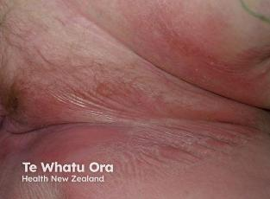
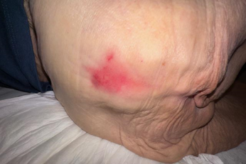
Incontinence vs Pressure Injury
Cause: prolonged moisture from urine and/or faeces
Location: buttocks, genital area, groin, inner thighs
Appearance: poorly defined edges, multiple, superficial red intact, or weeping skin that can be painful
Cause: prolonged pressure
Location: over bony prominence or from a device
Appearance: localised areas of non-blanching skin redness, blister or with skin and tissue breakdown with distinct edges, can be painful
Image sourced from DermNet​
Notes:
Urinary and faecal incontinence if left for prolonged periods on the skin can cause skin irritation and damage - it is like a burn, wet skin increases friction and breakdown and increases the risk of PIs developing. Pressure injuries and incontinence can both be present. It is important barrier creams are used to protect the skin from urine and faeces before the skin is red.

Slide 19
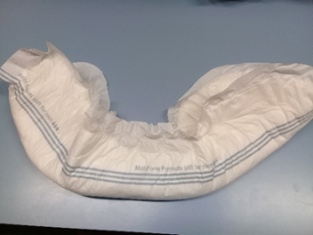
Incontinence pads
Pads are used to keep the resident socially continent and do not replace toileting.
Evening pads should be applied 8.30pm onwards to reduce sleep disturbance.
Ensure pads are folded lengthwise before applying to help shape the pad and aid absorbency. Loosen the leak guards to prevent leakage.
Following a bowel motion or faecal smearing change the pad immediately regardless of the wetness indicator.
Remember to use sparingly any creams or ointments as they can clog the pad and impair absorbency.

Slide 20
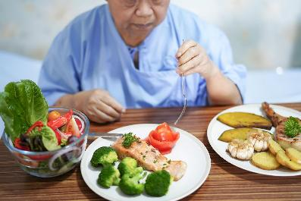
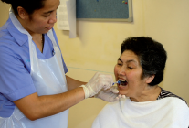
Nutrition
Food and fluids help to maintain skin health.
Report any reduced food and fluid intake, swallowing issues or loss of weight.
Report if urine becomes darker, cloudy, odour or pain when urinating or resident becomes confused.
Perform oral hygiene twice a day and ensure dentures fit well.
If identified the nurse should refer to a Dietitian.
Residents on nutritional supplement drinks should be served chilled, provide in 50-100ml volumes regularly during day to ensure these are consumed.
New Zealand Dental Association. 2010. Healthy Mouth, Healthy Ageing: Oral Health Guide for Caregivers of Older People​
Notes:
Malnutrition is a risk factor for PI development. Nutrition plays an important role in prevention and tx of PIs. Monitor daily food & fluid intake.. Poor oral hygiene increases the risk of systemic diseases such as heart problems, diabetes, respiratory infections hence regular mouth inspections & oral hygiene is essential, If dentures are not cleaned properly they can cause fungal and bacterial infections in the mouth, report and soreness or cracking at the corners of the mouth-bad breath.
Nutritional supplement drinks serve chilled & in small volumes during day to ensure they are consumed

Slide 21
SSKIN Recap
The SSKIN acronym alerts nurses and care-workers of strategies to prevent or manage pressure injuries
Apply SSKIN into your everyday practice
Report any resident concerns to your nurse
Can you remember what SSKIN stands for?
S = Surface
S= Skin Inspections
K = Keep Moving
I = Incontinence
N = Nutrition

Slide 22
Further Resources
Ask your Clinical Lead/Manager to access wider resources from the Pressure Injury Prevention Toolkit, including:
SSKIN poster
Mind Your Tone presentation
Moving, handling and equipment presentation
Skin care guide
Foot and hand care guide
Wound healing and nutrition handout
Terminology and definitions for care workers
Patient leaflets (several languages)
Teaching cards
HealthLearn resources overview

Slide 23
References
Beeckman et al. The Ghent Global IAD Categorisation Tool (GLOBIAD). Skin Integrity Research Group - Ghent University 2017. Available to download from www.UCVVGent.be
Fletcher J, Beeckman D, Boyles A et al (2020) International Best Practice Recommendations: Prevention and management of moisture-associated skin damage (MASD). Wounds International. Available online at www.woundsinternational.com
Health Quality & Safety Commission New Zealand. (2023). Pressure injury | Whara pēhanga (Frailty care guides 2023). Retrieved August 21, 2025, from https://www.hqsc.govt.nz/resources/resource-library/pressure-injury-whara-pehanga-frailty-care-guides-2023/
New Zealand Dental Association. 2010. Healthy Mouth, Healthy Ageing: Oral Health Guide for Caregivers of Older People. Auckland: New Zealand Dental Association. https://www.nzda.org.nz/assets/resources/Order_Resources/Healthy_Mouth_Healthy_Ageing.pdf
National Pressure Injury Advisory Panel, European Pressure Ulcer Advisory Panel and Pan Pacific Pressure Injury Alliance. Prevention and Treatment of Pressure Ulcers/Injuries: Quick Reference Guide. The International Guideline: Fourth Edition. Emily Haesler (Ed.). 2025. [cited: 13 Aug 2025]. Available from: https://internationalguideline.com.
New Zealand Spinal Trust. Pressure areas and their management. Retrieved August 21, 2025, from https://nzspinaltrust.org.nz/new-to-sci/skin-care/pressure-areas/
New Zealand Wound Care Society: https://nzwcs.org.nz/
O'Brien N, Moore Z, Avsar P, Patton D, Nugent L, O'Connor T. The impact of healthcare assistant education on pressure ulcer prevention: a systematic review. J Wound Care. 2023 Jul 1;32(Sup7a):cxv-cxxvii. doi: 10.12968/jowc.2023.32.Sup7a.cxv. PMID: 37405970.
Prevention and Treatment of Pressure Ulcers/Injuries: Clinical Practice Guideline. The International Guideline. Emily Haesler (Ed.). EPUAP/NPIAP/PPPIA: 2019.
New Zealand Spinal Trust. Pressure areas and their management. Retrieved August 21, 2025, from https://nzspinaltrust.org.nz/new-to-sci/skin-care/pressure-areas/
Notes:
The NZ Spinal Trust has further resources on their website for more info on preventing PI in residents with spinal cord injuries.

