Slide 1
Additional resources
Anj Dickson

Slide 2
PPPIA Pressure Injury Classification Systems
The tools below include adapted text from the NPUAP/EPUAP International Pressure Ulcer Classification System (2014), 3D graphics and photographs to assist health professionals in multicultural settings to identify and classify pressure injuries
For more information, visit: https://pppia.org/pppia-resources

Slide 3
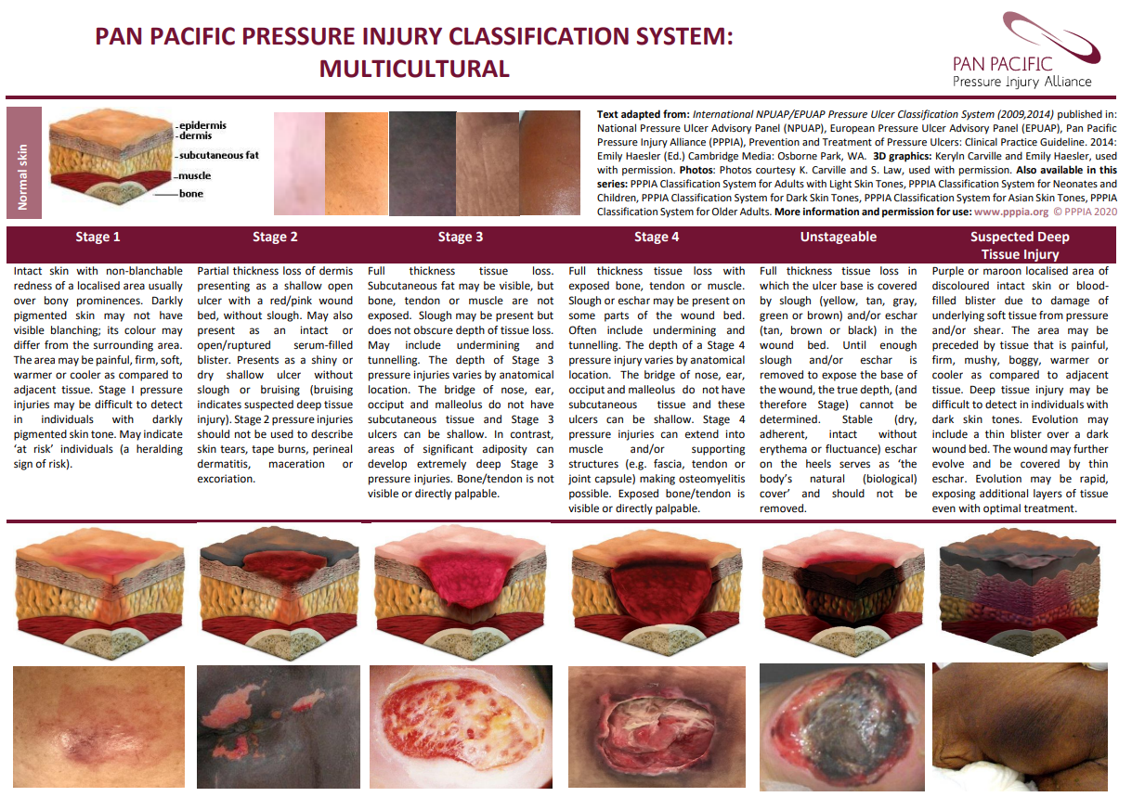

Slide 4
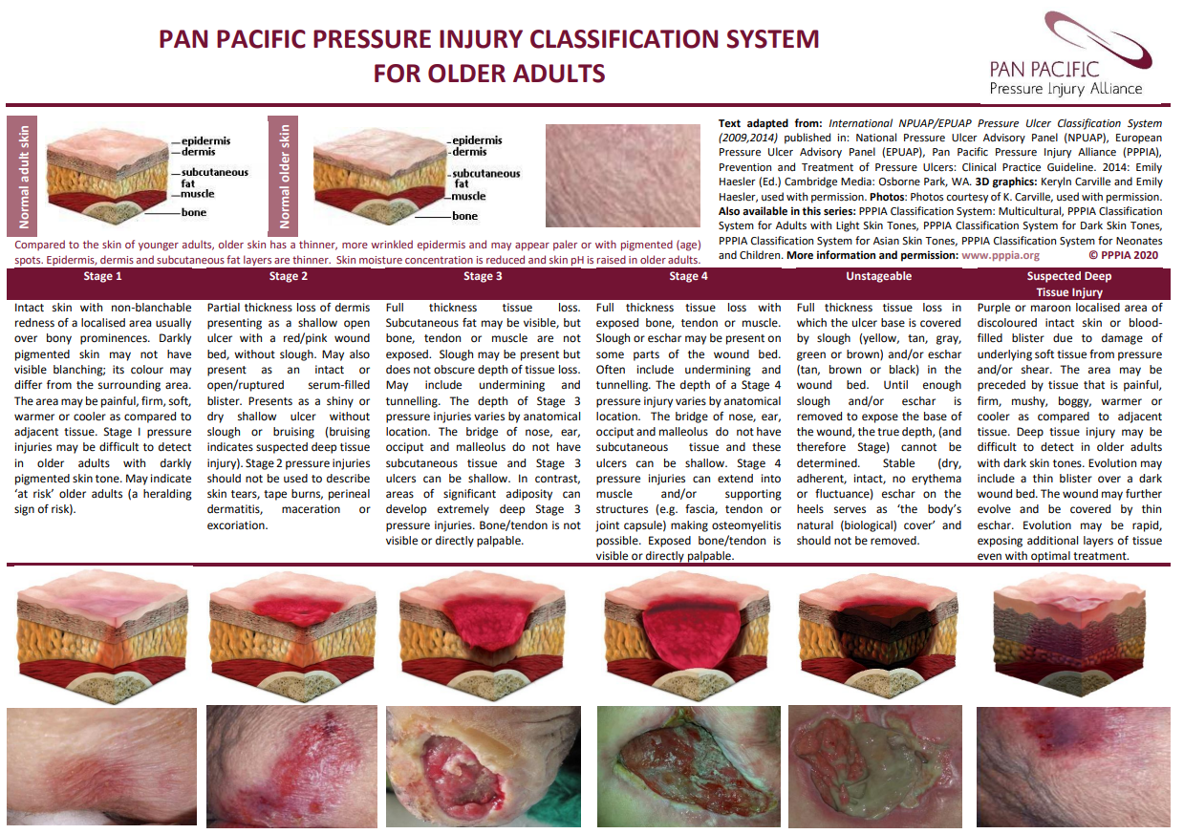

Slide 5
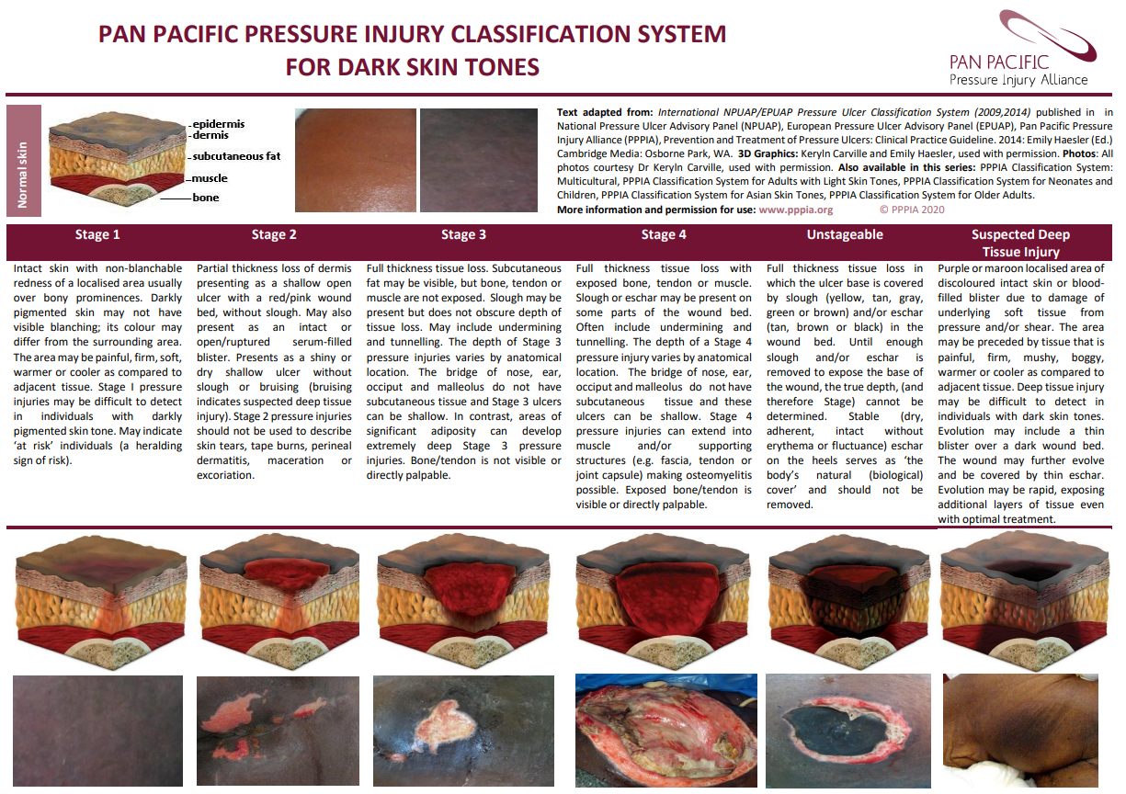

Slide 6
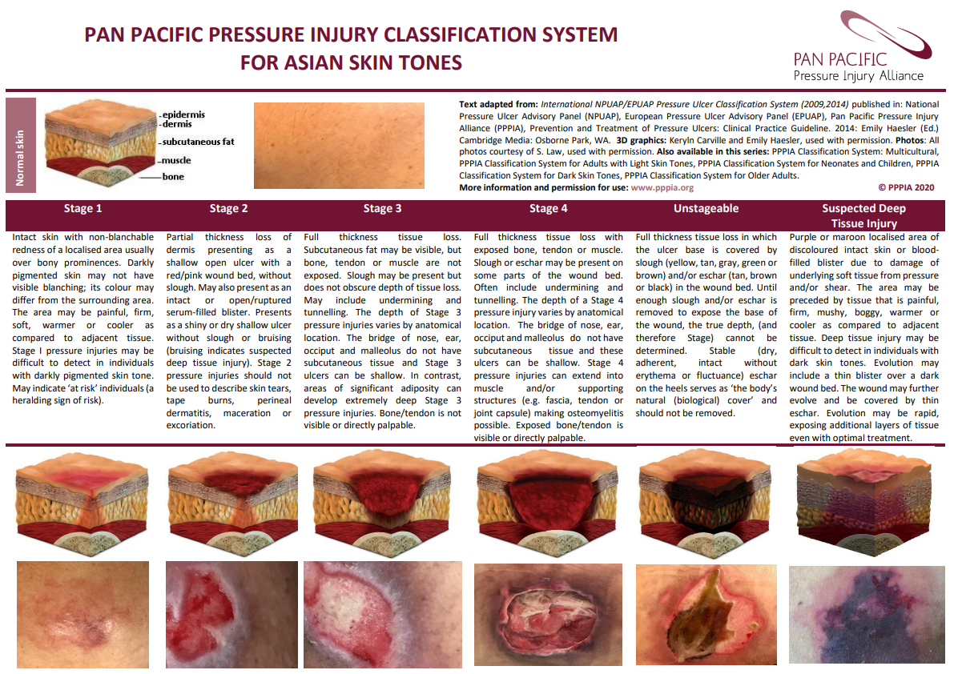

Slide 7
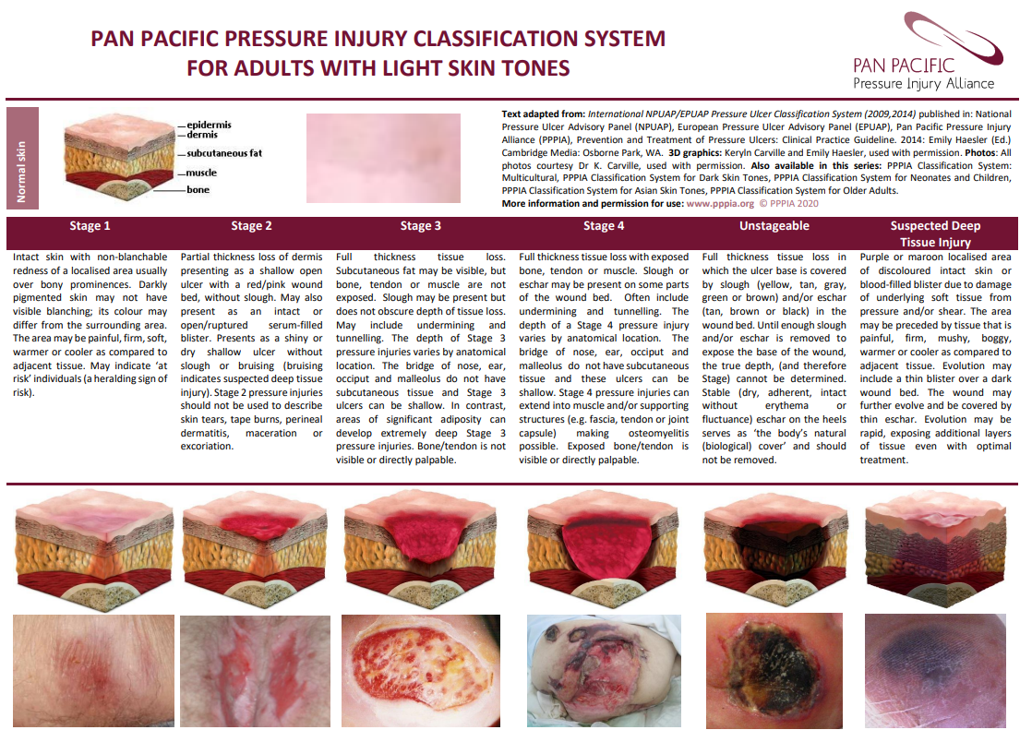

Slide 8
Additional Resources
Early identification of pressure injuries in people with dark skin tones: Qualitative perspectives from community-based patients and their carers. https://pubmed.ncbi.nlm.nih.gov/38979901/
Addressing skin tone bias in wound care: assessing signs and symptoms in people with dark skin tones. 191ac9b79f47de2896cf1a30f39037f5.pdf
Community Nurses' Experiences Assessing Early-Stage Pressure Injuries in People With Dark Skin Tones: A Qualitative Descriptive Analysis. Community Nurses' Experiences Assessing Early-Stage Pressure Injuries in People With Dark Skin Tones: A Qualitative Descriptive Analysis - PubMed
Current Perspectives on Pressure Injuries in Persons with Dark Skin Tones from the National Pressure Injury Advisory Panel. https://pubmed.ncbi.nlm.nih.gov/37590446/
Pressure injuries and skin tone diversity in undergraduate nurse education: Qualitative perspectives from a mixed methods study. https://pubmed.ncbi.nlm.nih.gov/34245169/
Pressure ulcers and skin tone. https://woundsinternational.com/made-easy/pressure-ulcers-and-skin-tone/
Notes:
In the 2018 Census – there was 179 Ethnicities identified within New Zealand, so there is a large representation of ethnicities within NZ, although 70% identified as European, 16.5% as Maori, 15.1% as Asian, 8.1% Pacifica, 1.5% Middle Eastern/Latin American /African ethnicity.
Cultural diversity is important to consider in the world of pressure injuries, because with Cultural diversity comes with it Skin tone variation and that is the important thing to acknowledge.

Slide 9
Ngā mihi nui

